Slide 1
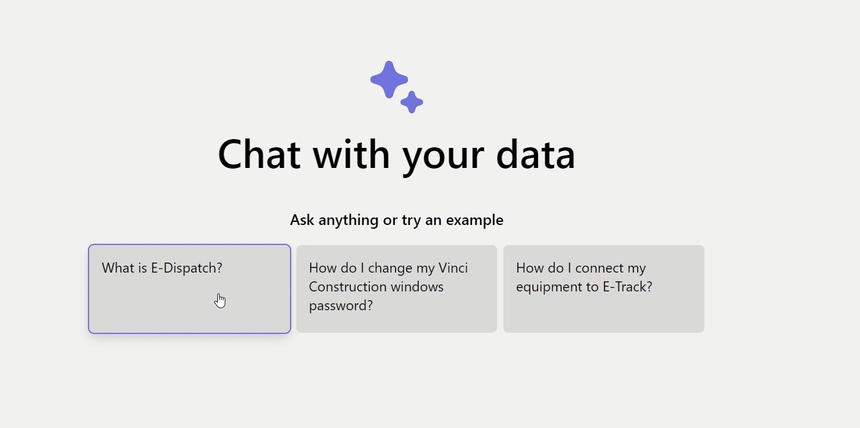
VCSI Data & AI
Presentation AI part

Slide 2


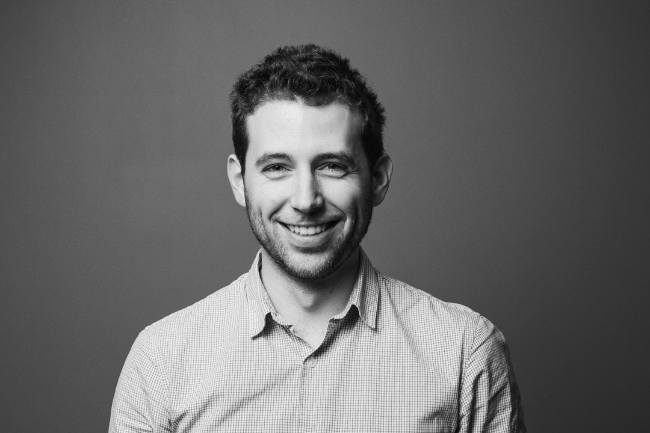
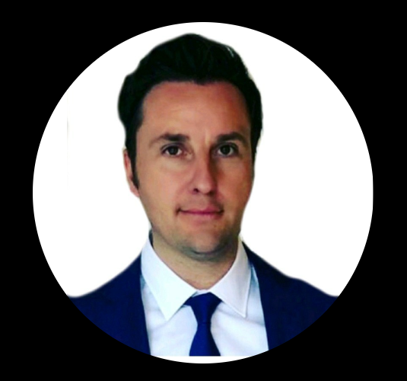

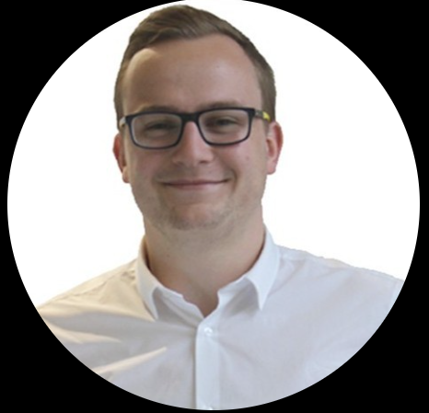


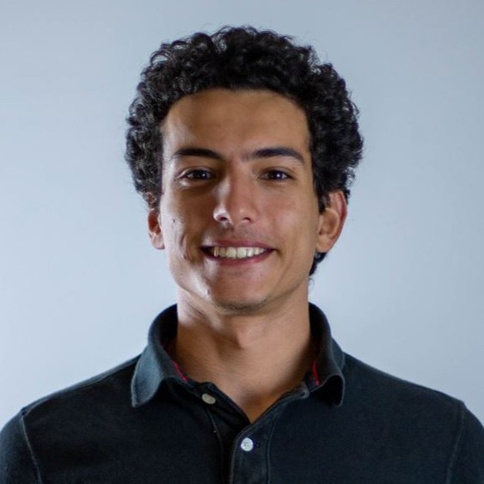
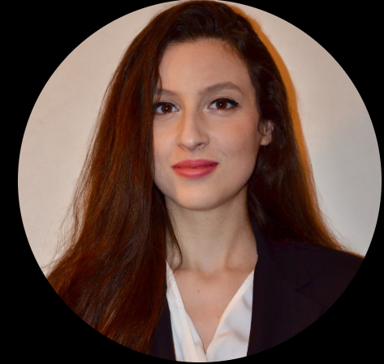
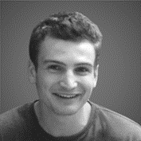

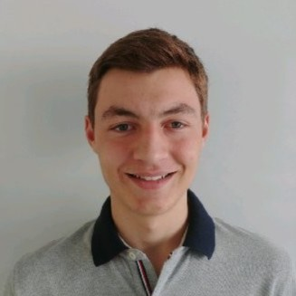
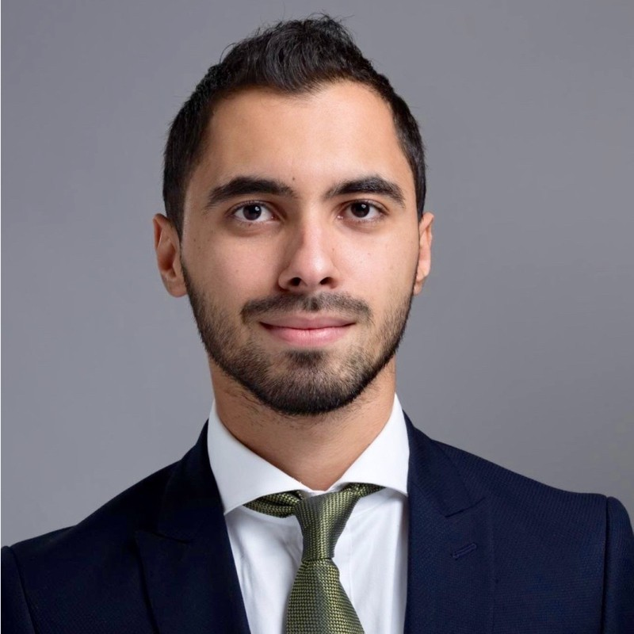
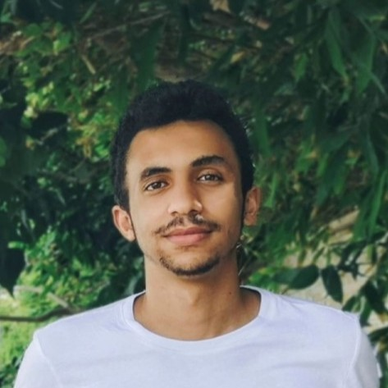
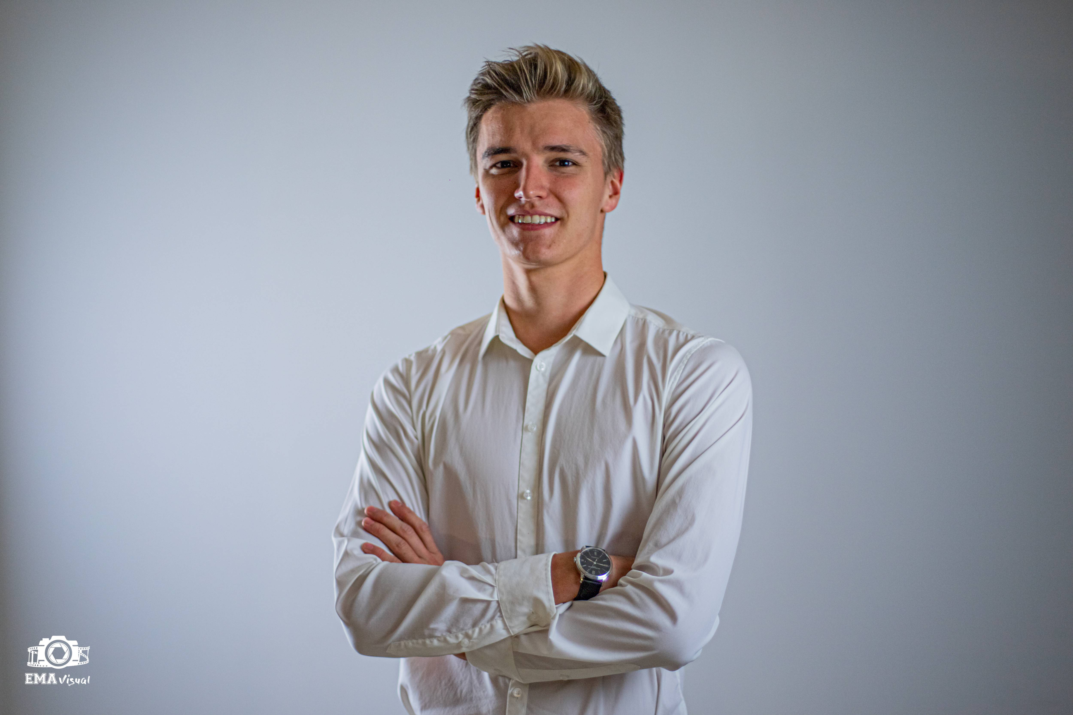
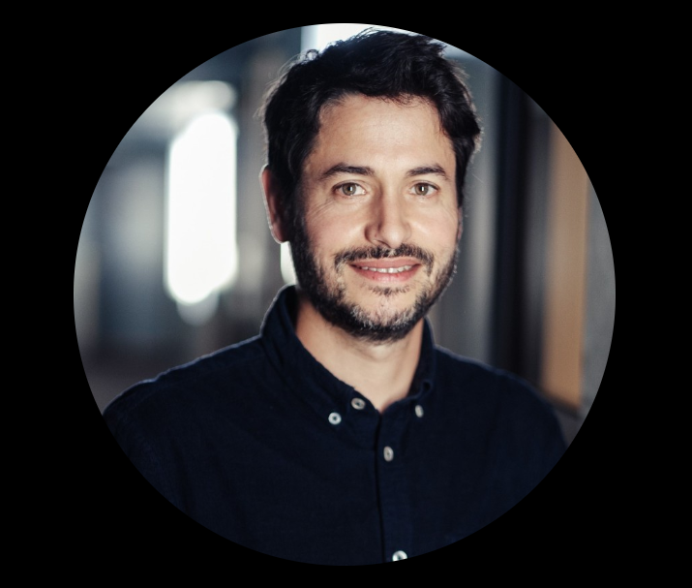

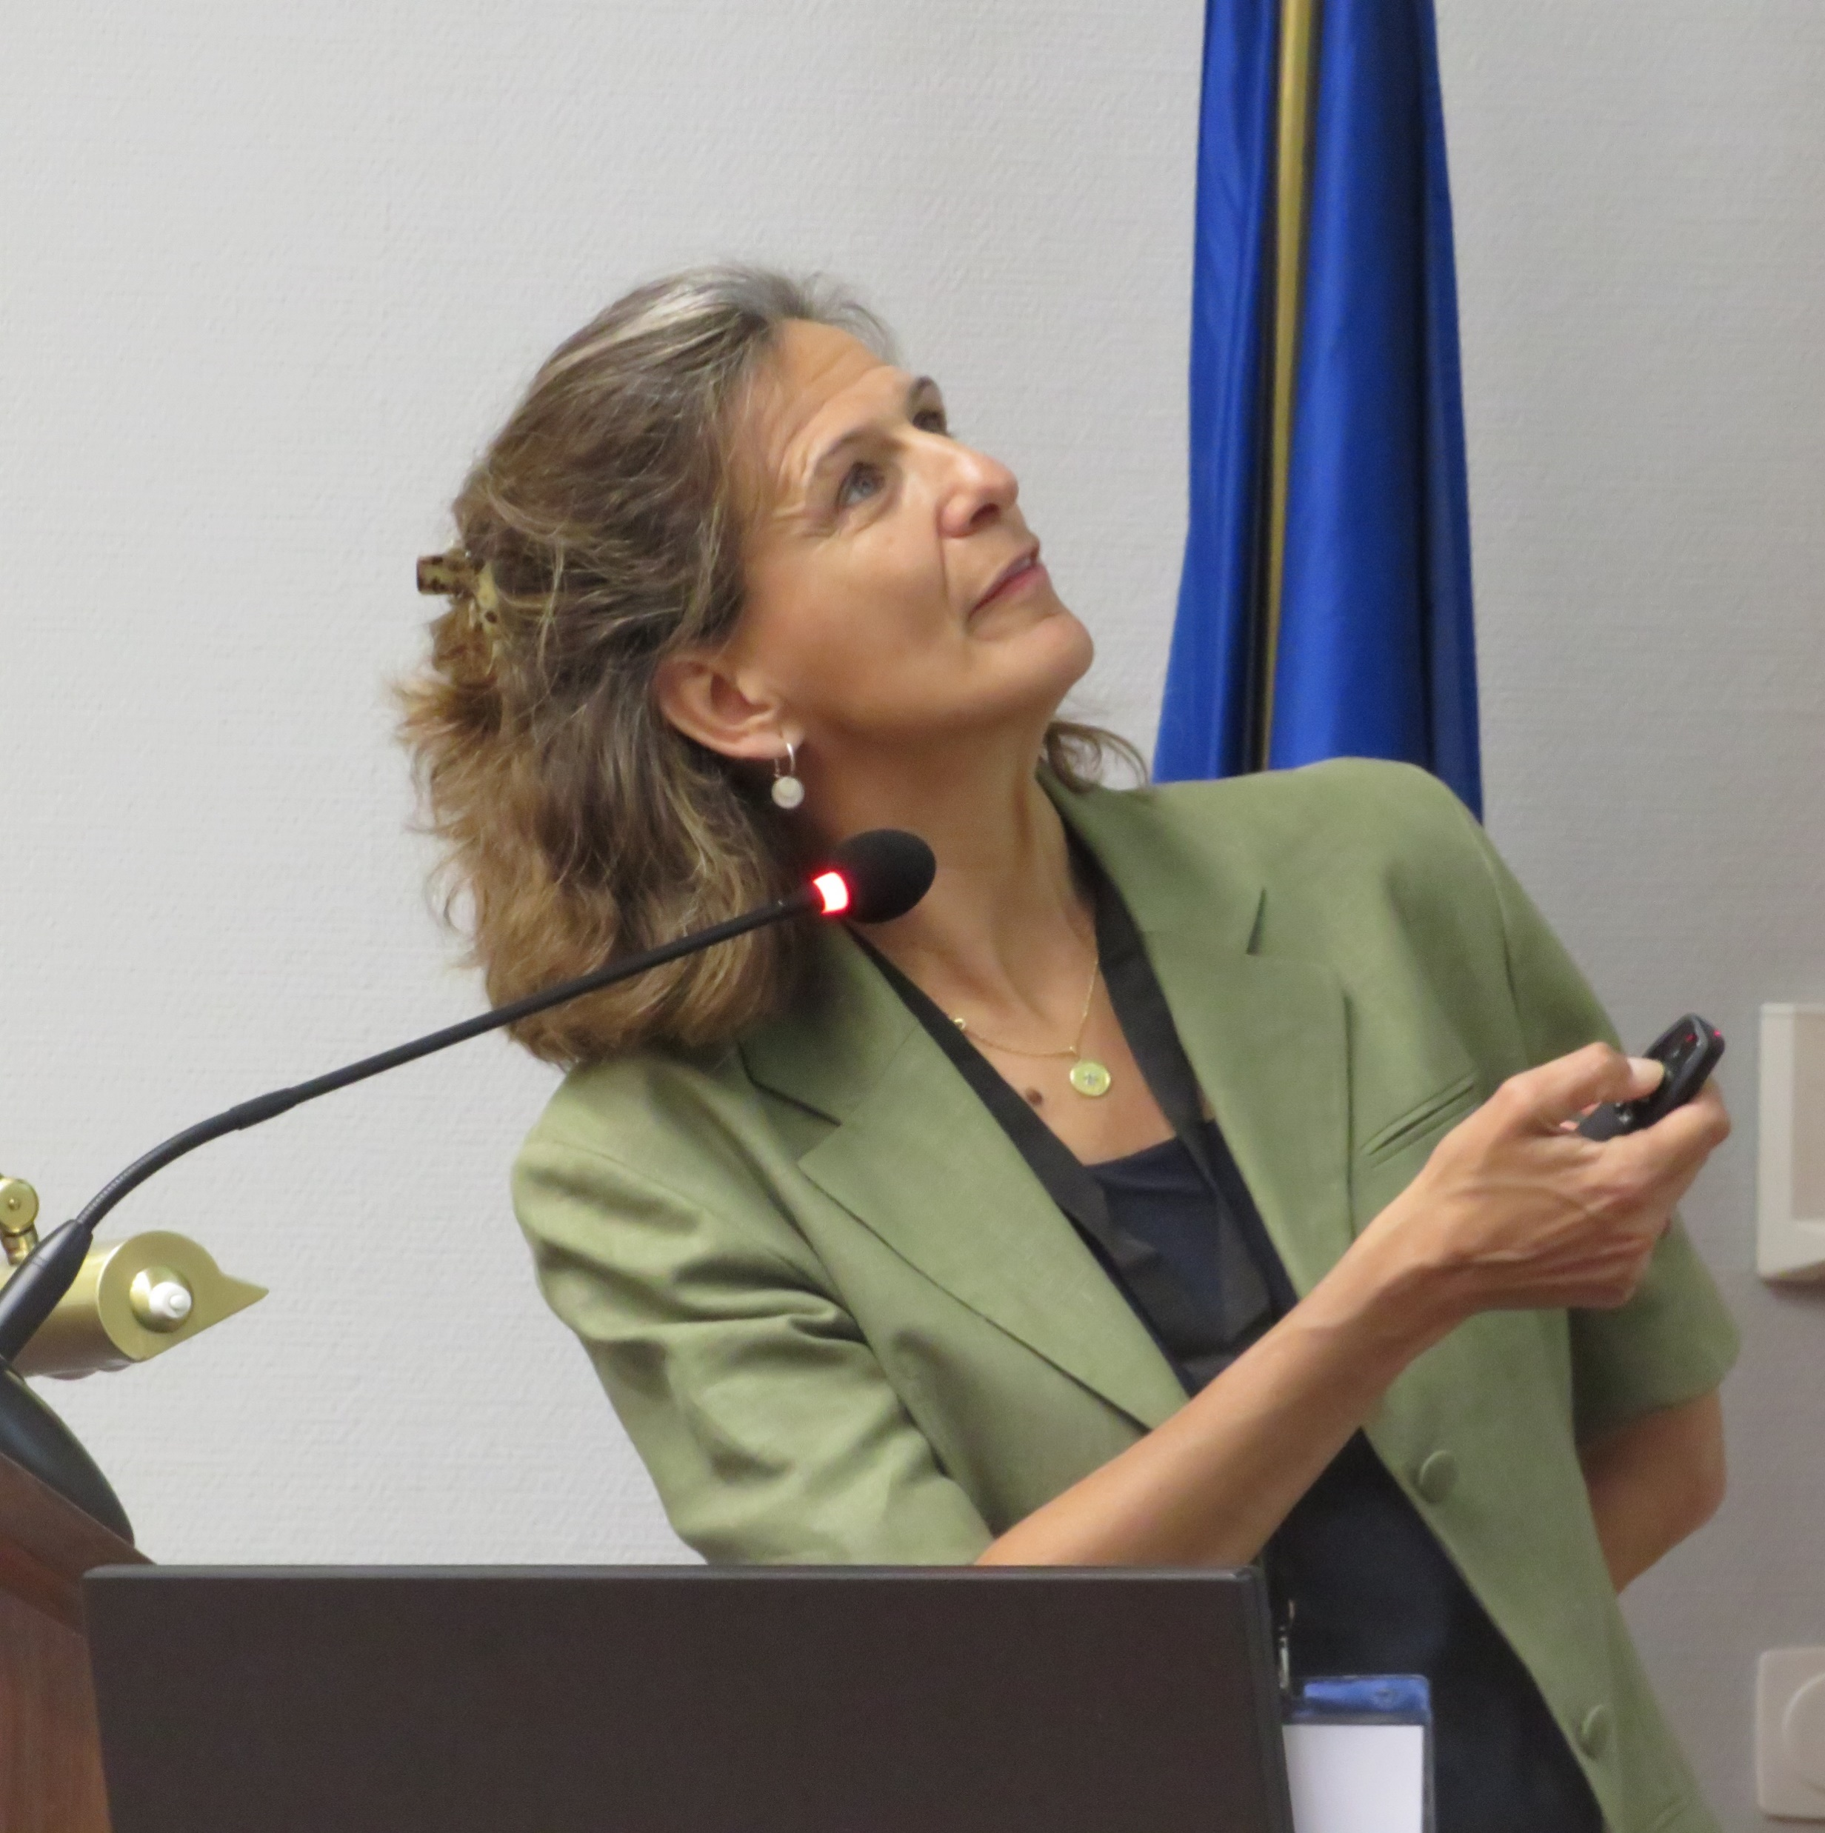
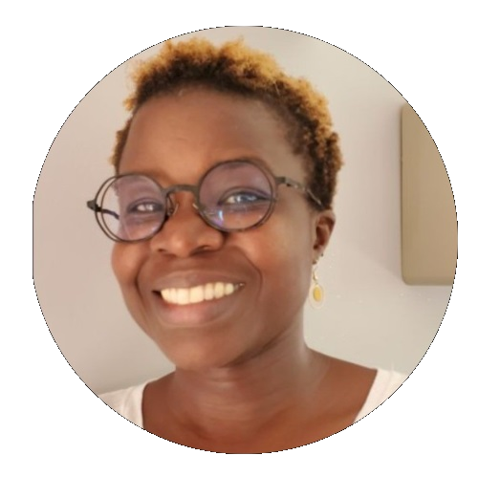






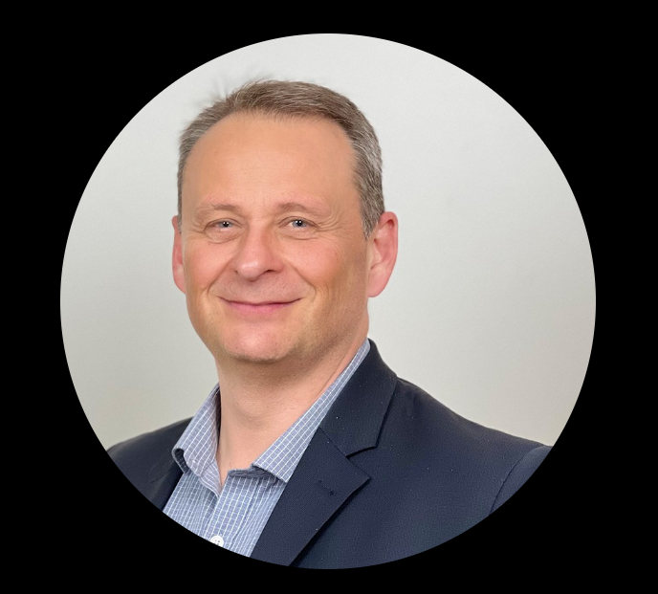

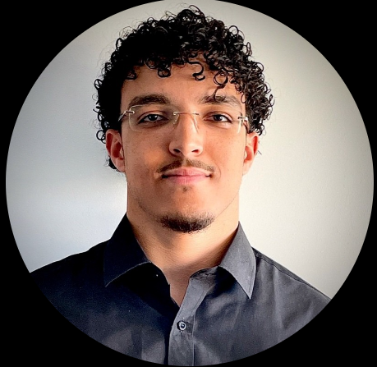
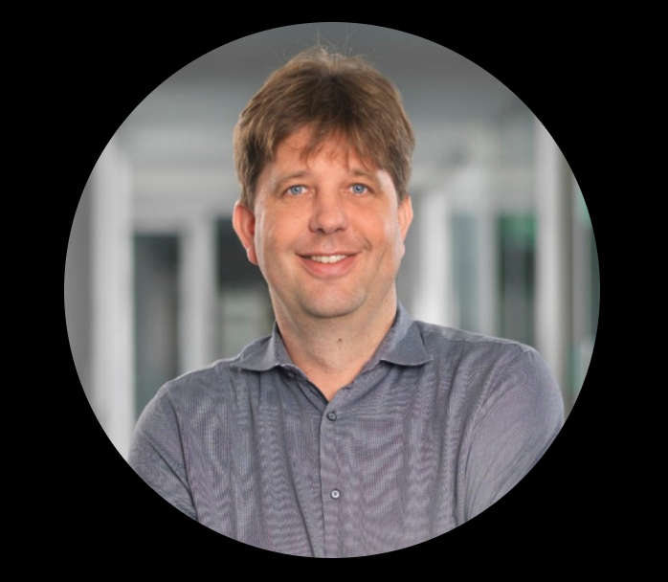
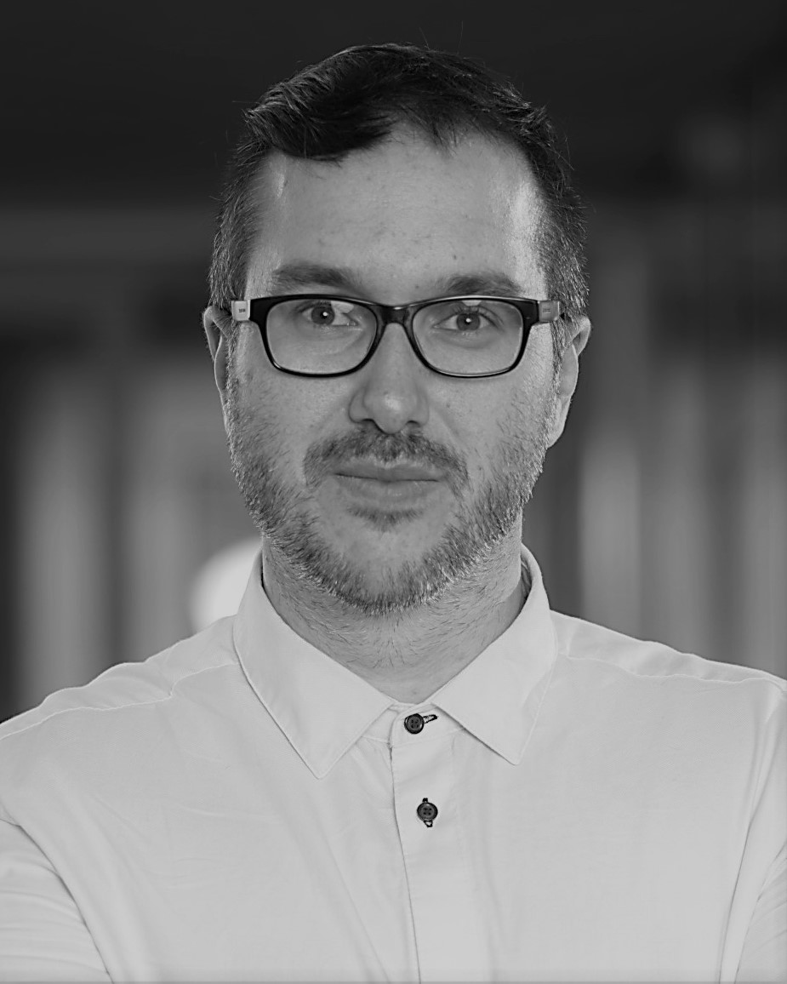
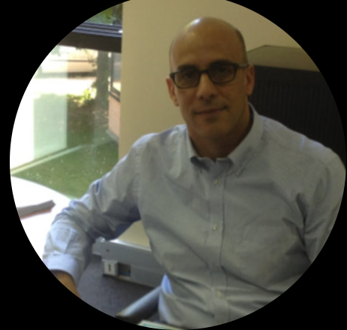
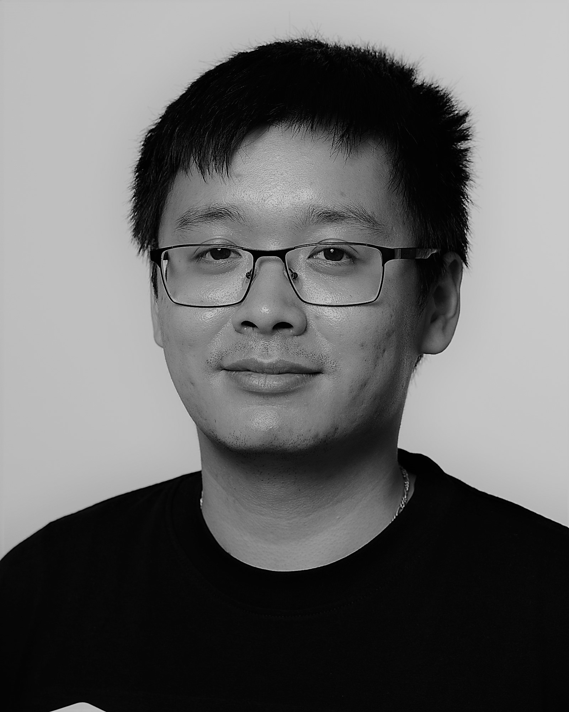

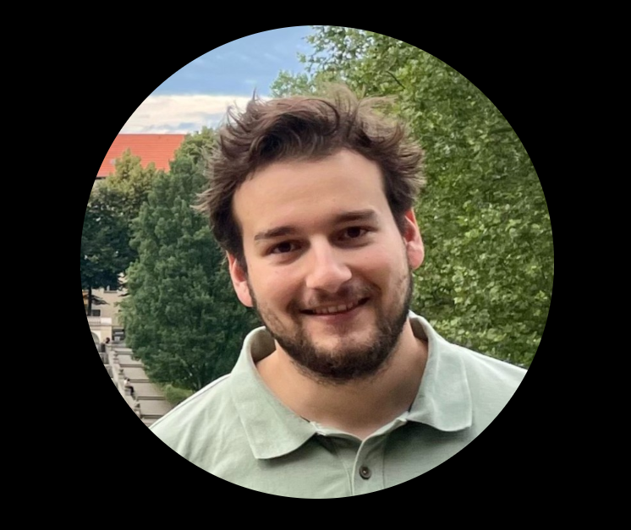

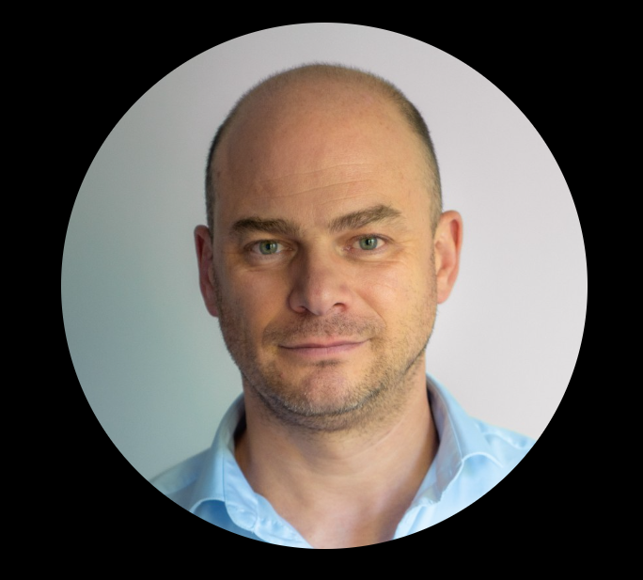
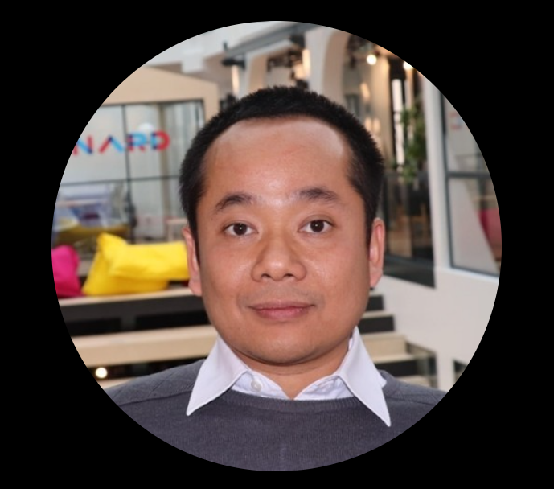

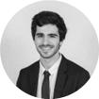

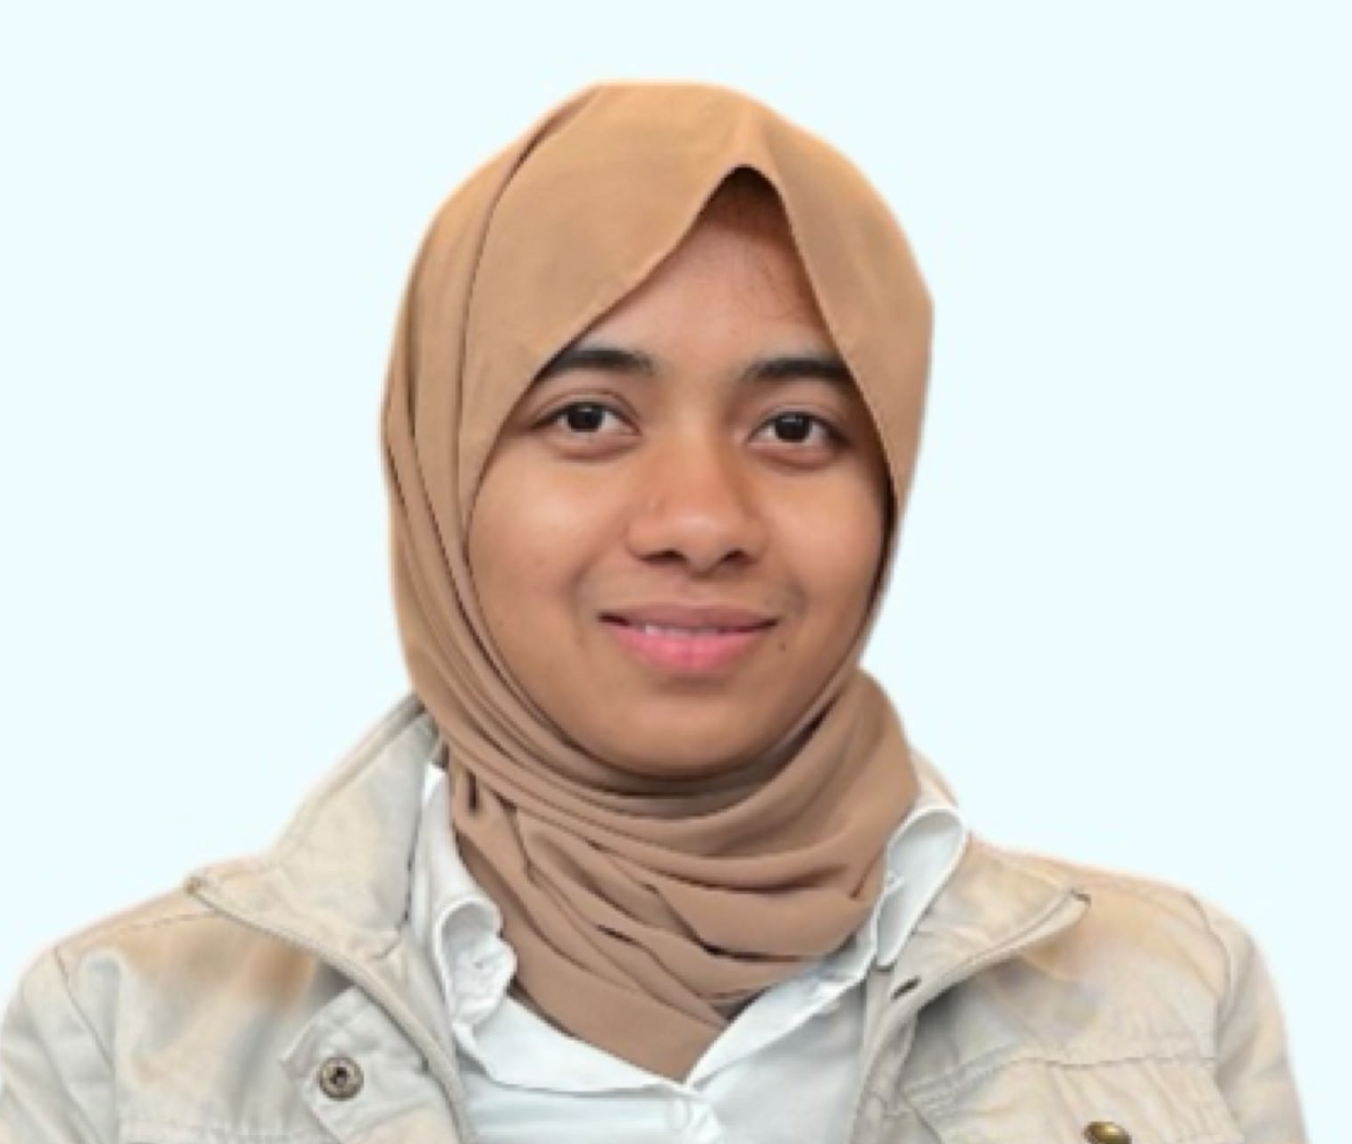
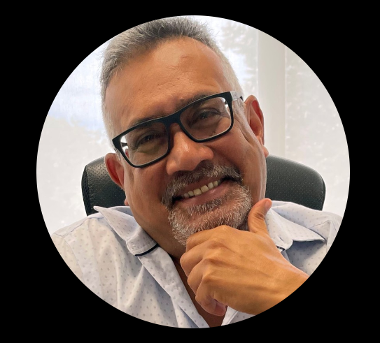
Over 30 data scientists across Vinci Construction
VCSI Datalab
Camille Vaneenoge
Manager
Victorien Melot
AI Lead
VCSI France
UK
Alexandre COUSIN
Manager
Marc JOURNE
Data Scientist
Quentin CHICHERY
Data Scientist
Paul McNally
Data Scientist
Samuel Newman
Data Scientist
David VATER
Data Scientist
Paul
MULLER
Nizar
CHAFII
Ali
OUARDI
Malek
FARHAT
Ugo
LE MORVAN
Imane
AGHMARI
Soletanche Bachy
Alexandre Scarwell​
Ingénieur logicielle
2 Data Engineer
Data Scientist
Data Scientist
Data Scientist
Data Scientist
Data Scientist
Data Scientist
I²A Mérignac
Kamal Berrada
Manager
Sixense Satellite
Blanca PAYAS
BU Manager
Fifame KOUDOGBO
EO applications
specialist
+30
data scientists
Jonathan TOURAILLE
Data Scientist
Aymane GOURIMATE
Data Scientist, PhD
Joan SALA
Data Scientist
Elise BACHELLERIE
Data Scientist
Sixense Digital
Frederic Delrieu​
Manager
2TMF
Patrice HENRI-TOSCANO
Ingénieur R&D
Some uses of AI in their software
Yann Garcin
Data Engineer
Amine Dhane
Data Scientist
VIA IMC
Sixense Engineering
Dirk EBERSBACH
Manager
Christian WÖRNER
CTO
Alexis Bigot​
Data Scientist
Sofiane HADJI ​
Data Scientist, PhD
Menard
Simon BUNIESKI
Manager
Diagway
Son Pham
Data Scientist
Andreas Ellinger
Data Scientist
Moneer Martini
Data Scientist
Marc HENRIOT
Manager
Tien Sy NGUYEN
CTO Dr. Data Scientist
Tolu OLUSOOTO
Data Scientist
Leopold MALET​
Data Scientist
SHEIK ABDULLAH Sameera Holy
Data Scientist
Nuvia
WAQAR Hassan​
Data Scientist
Sandip GOWAMI​
Manager
+ ? Data scientist
+ Network of Python enthusiasts (Spain: Eduardo MARTINEZ, USA: Venkata MUPPANA, Canada: Iman ENTEZARI)

Slide 3
Our 3 missions on 3 technologies
Deliver Use Cases
Data
Define, build and maintain Use Cases, mainly central
Deliver with agility thanks to cross-functional teams
Animate and empower community
Artificial intelligence
Community gathering all stakeholders (Business, IT, External partners)
Training, Coaching and expertise
Define and implement governance
No Code / Low Code
People, process and tools
Based on community feedback

Slide 4
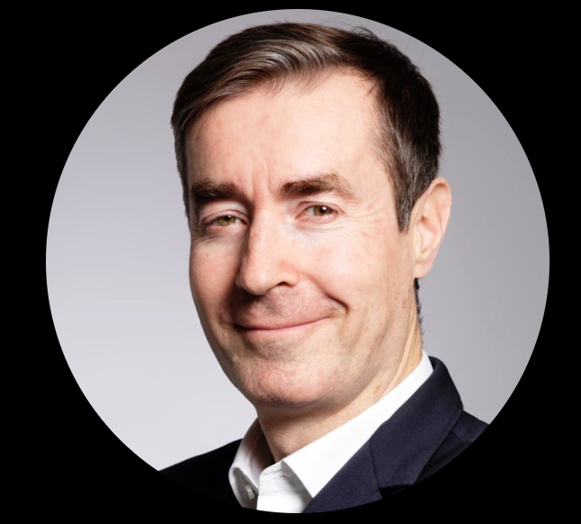
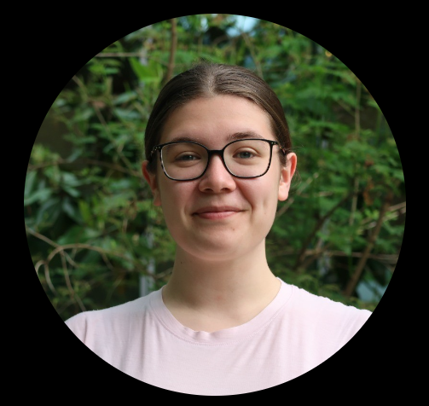
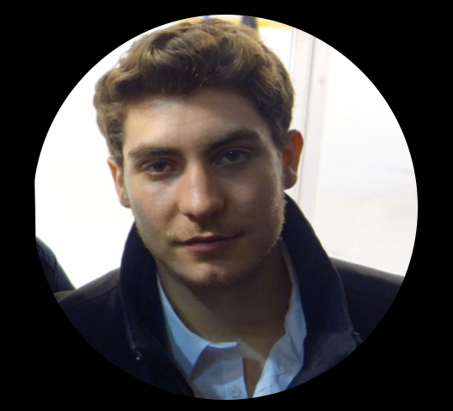

Data & AI– Vinci Construction SI
Vinci Construction SI
entity
Olivier PELLET
DSI
Camille Vaneenoge
Data & AI Lead
Victorien Melot
AI Lead
2021
AI team creation
Paul MULLER
Data Scientist Sr.
Nizar CHAFII
Data Scientist Sr.
Imane AGHMARI
Data Scientist Sr
Ugo LE MORVAN
Data Scientist
Re-invoicing + IT fees
funding
DELIVERY
Malek FARHAT
Data Scientist
Ali OUARDI
Data Scientist
Julie Pessey
Data Scientist
intern
Romain SCHALLER
DEV Python
AI expertise
NLP & LLM
Industrialization architecture and Azure
Ideation & community
Rania SOUISSI
AI Project Manag
intern
Governance

Slide 5
People working with us
Architecture
DevOps
Simon SOULIE
DevOps
30%
Thomas Marencic
Architect expert
5%
Mhenni CHERAFT
Architect expert
5%
Dev Front
Yuktha
Dev FullStack
30%
Paul LALOYEAU
Lead DEV
5%

Slide 6


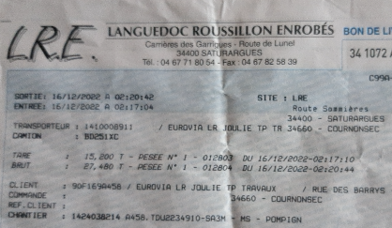

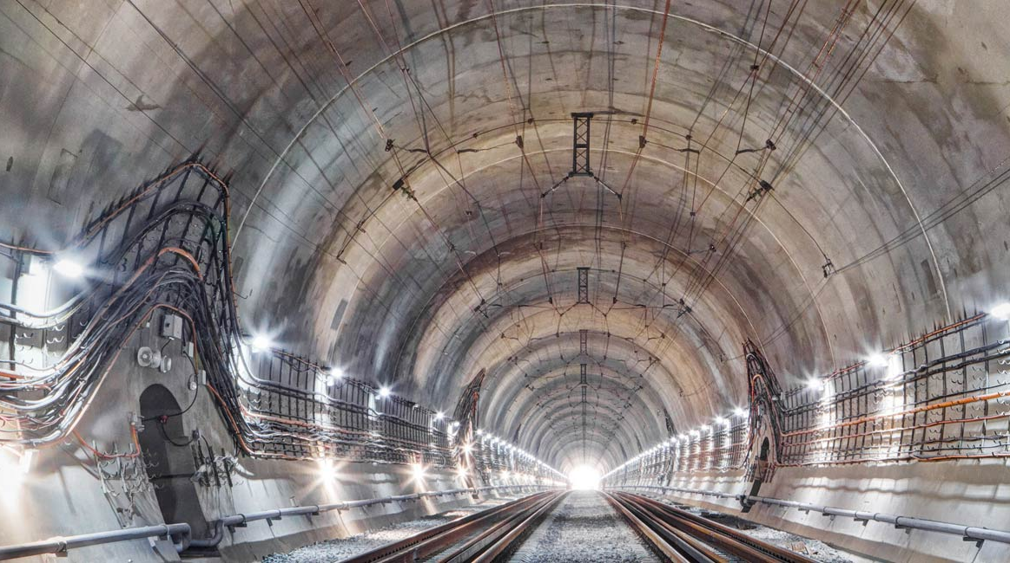
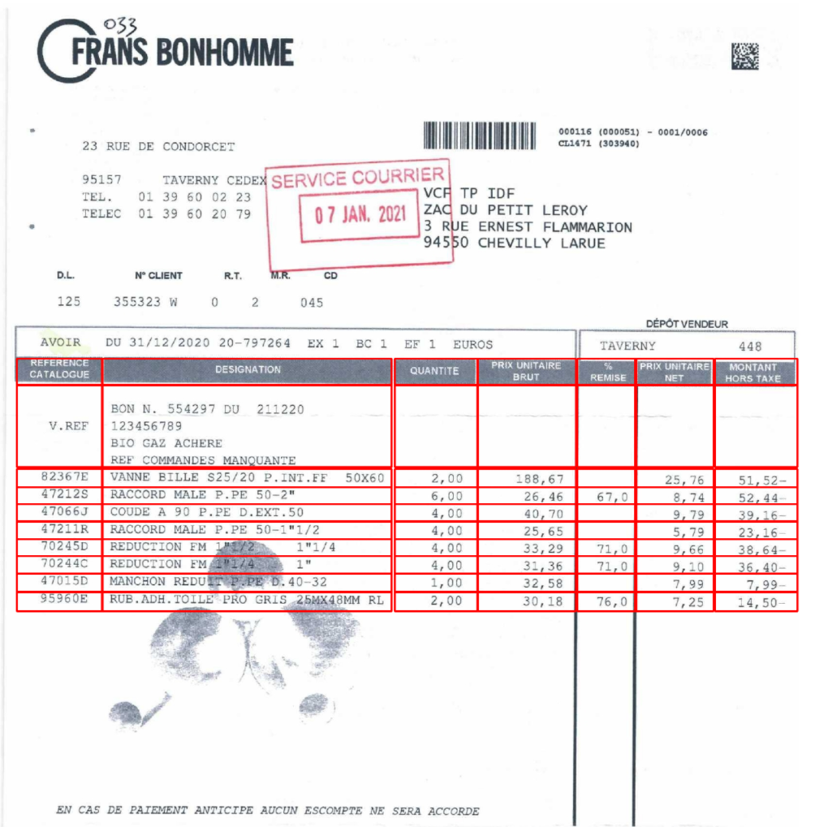
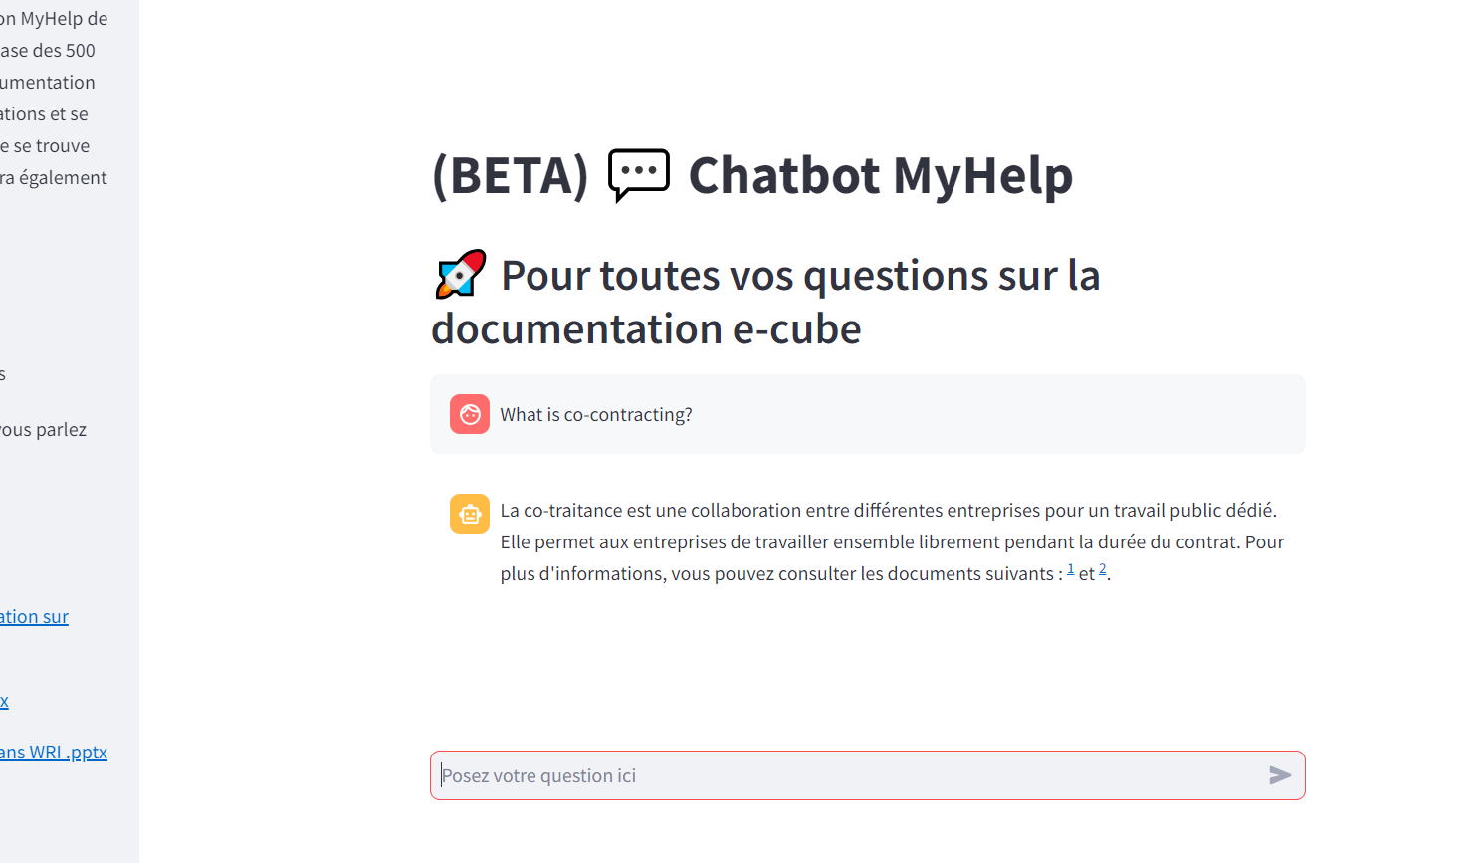
Current VCSI projects
RUN/Deployment
On DEV
Ideas
SELECT
CLARA
Demat BL
Carbon counting
Technical review contract
SELECT light
Invoice/agreement contract comparison
Analyses of tenders
Automatic legal review contract
Dematerialization of delivery notes
Calculate the carbon footprint of invoices
LLM-NLP
LLM
Tunnel Factory lot 2
Automatic Quote E-Proc
Chatbot Multi Domain
IT-ticket classification
Stopped
Conveyor predictive maintenance
Accident prediction
Gen MT
Chatbot on internal documents
Classification of IT e-mail support
Automatic creation of orders from QUOTATIONS
E-Care data anonymization
LLM
LLM
Common bricks AI
API for LLM common tools for VINCI Construction
Anonymization of E-Care Data

Slide 7





Example: SELECT timeline
Jul 2022
Nov 2022
Nov 2022
May 2023
Jul 2023
Apr 2024
May 2024
Jul 2024
FRAMING
LEONARD
INDUSTRIALISATION
DEPLOYMENT
EXTENSION
Notes:
Message 2 - PIERRE Et maintenant ? Adaptation et extension vers d’autres périmètres.
l’objectif est de le déployer dans les autres divisions qui ont parfois des métiers différents.
Il va donc falloir regarder comment nous pouvons adapter nos algorithmes.
Message 3 – VICTORIEN Et extension vers de nouvelles fonctionnalités
La suite vers l’aide pendant la phase d’étude de l’offre voir la rédaction du mémoire technique.
Et également, les utilisateurs commencent à nous demande des champs d’extraction, mais on se rend compte que ne ce sont pas des champs qui permette la sélection de l’appel d’offre mais plus qui aide à l’étude de l’offre.

Slide 8
5 Golden Rules matrix for AUTO-ITP
# | RULES | DESCRIPTION | Y/N | Risks |  |  | Precisions / Comments
1 | SCOPE | SCOPE DEFINED AND SHARED | Y |  |  |  | Low visibility on perimeters
 |  | OBJECTIVES & PRIORITIES DEFINED AND SHARED | Y |  |  |  | Need Roadmap
 |  | BUDGET VALIDATED | N |  |  |  | No global budget for 2025
2 | TEAM | BUSINESS LEADER APPOINTED (AND AVAILABLE) | Y |  |  |  | Sapna NEGI
 |  | IT LEADER APPOINTED (AND AVAILABLE) | Y |  |  |  | Victorien MELOT
 |  | TEAM STAFFED (BUSINESS, IT INTERNAL, IT EXTERNAL) WITH REQUIRED SKILLS BY PROJECT AND AVAILABLE FOR PROJECTS | Y |  |  |  | Business: Samuel It internal: Ugo LM IT external: Romain S., Simon S.
3 | PROJECT MANAGEMENT & GOVERNANCE | ROLES AND RESPONSIBILITIES DEFINED | N |  |  |  | We need RACI
 |  | GOVERNANCE MEETINGS DEFINED AND IN PLACE TO REVIEW PROGRESS/ISSUES/SCOPE MANAGEMENT/PRIORITIES/ABRITRATION | Y |  |  |  | Technical weekly, weekly per domain, Steerco need to be done
 |  | BUSINESS SPONSOR AND IT SPONSORS (DIRECTOR) ASSIGNED AND AVAILABLE AT STEERING COMMITTEES | Y |  |  |  | Business : Yogesh PATEL IT : Camille VANEENOGE
4 | METHODOLOGY | APPROACH, ORGANISATION, METHODOLOGY, DELIVERABLES ADAPTED TO PROJECT CONTEXT DEFINED AND SHARED | Y |  |  |  | Methodology to shared with everyone
 |  | GO/NO GO STEERING COMMITTEE BEFORE OFFICIAL PROJECT LAUNCH | Y |  |  |  | To be scheduled
 |  | PHASE GATES PROCESS VALIDATION / KICK-OFF AT EACH PHASE OF THE PROJET | Y |  |  |  | Need to be done before deployment
5 | RISK MANAGEMENT | SUCCESS FACTORS & RISKS IDENTIFIED | Y |  |  |  | Success factors & risks need to be identified
 |  | STABLE BUSINESS ORGANIZATION CONTEXT (E.G. NO DEPLOYMENTS WITH REORG…)
 |  | INCLUDE CONTINGENGY FOR UNEXPECTED AND UNDERESTIMATED TOPICS (CHANGE/TRAINING/HYPERCARE/INTERFACES/REFERENTIAL/AUTHORIZATIONS/REPORTS/INFRASTRUCTURE/CYBERSECURITY)

Slide 9
5 Golden Rules matrix for BID TAILOR
# | RULES | DESCRIPTION | Y/N | Risks |  |  | Precisions / Comments
1 | SCOPE | SCOPE DEFINED AND SHARED | N |  |  |  | Low visibility on perimeters
 |  | OBJECTIVES & PRIORITIES DEFINED AND SHARED | Y |  |  |  | Need Roadmap
 |  | BUDGET VALIDATED | Y |  |  |  | No global budget for 2025
2 | TEAM | BUSINESS LEADER APPOINTED (AND AVAILABLE) | Y |  |  |  | Sapna NEGI
 |  | IT LEADER APPOINTED (AND AVAILABLE) | Y |  |  |  | Victorien MELOT
 |  | TEAM STAFFED (BUSINESS, IT INTERNAL, IT EXTERNAL) WITH REQUIRED SKILLS BY PROJECT AND AVAILABLE FOR PROJECTS | Y |  |  |  | Business: Paul M It internal: Ugo LM IT external: Romain S., Simon S.
3 | PROJECT MANAGEMENT & GOVERNANCE | ROLES AND RESPONSIBILITIES DEFINED | N |  |  |  | We need RACI
 |  | GOVERNANCE MEETINGS DEFINED AND IN PLACE TO REVIEW PROGRESS/ISSUES/SCOPE MANAGEMENT/PRIORITIES/ABRITRATION | Y |  |  |  | Technical weekly, weekly per domain, Steerco need to be done
 |  | BUSINESS SPONSOR AND IT SPONSORS (DIRECTOR) ASSIGNED AND AVAILABLE AT STEERING COMMITTEES | Y |  |  |  | Business : Yogesh PATEL IT : Camille VANEENOGE
4 | METHODOLOGY | APPROACH, ORGANISATION, METHODOLOGY, DELIVERABLES ADAPTED TO PROJECT CONTEXT DEFINED AND SHARED | Y |  |  |  | Methodology to shared with everyone
 |  | GO/NO GO STEERING COMMITTEE BEFORE OFFICIAL PROJECT LAUNCH | Y |  |  |  | Done in October 2024
 |  | PHASE GATES PROCESS VALIDATION / KICK-OFF AT EACH PHASE OF THE PROJET | Y |  |  |  | Need to be done before deployment
5 | RISK MANAGEMENT | SUCCESS FACTORS & RISKS IDENTIFIED | Y |  |  |  | Success factors & risks need to be identified
 |  | STABLE BUSINESS ORGANIZATION CONTEXT (E.G. NO DEPLOYMENTS WITH REORG…)
 |  | INCLUDE CONTINGENGY FOR UNEXPECTED AND UNDERESTIMATED TOPICS (CHANGE/TRAINING/HYPERCARE/INTERFACES/REFERENTIAL/AUTHORIZATIONS/REPORTS/INFRASTRUCTURE/CYBERSECURITY)

